Slide 1
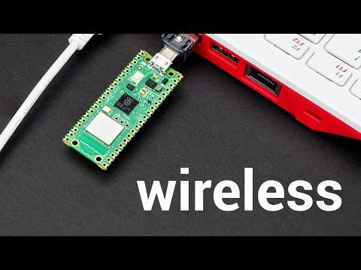
Overview of Raspberry Pi Pico W

Slide 2
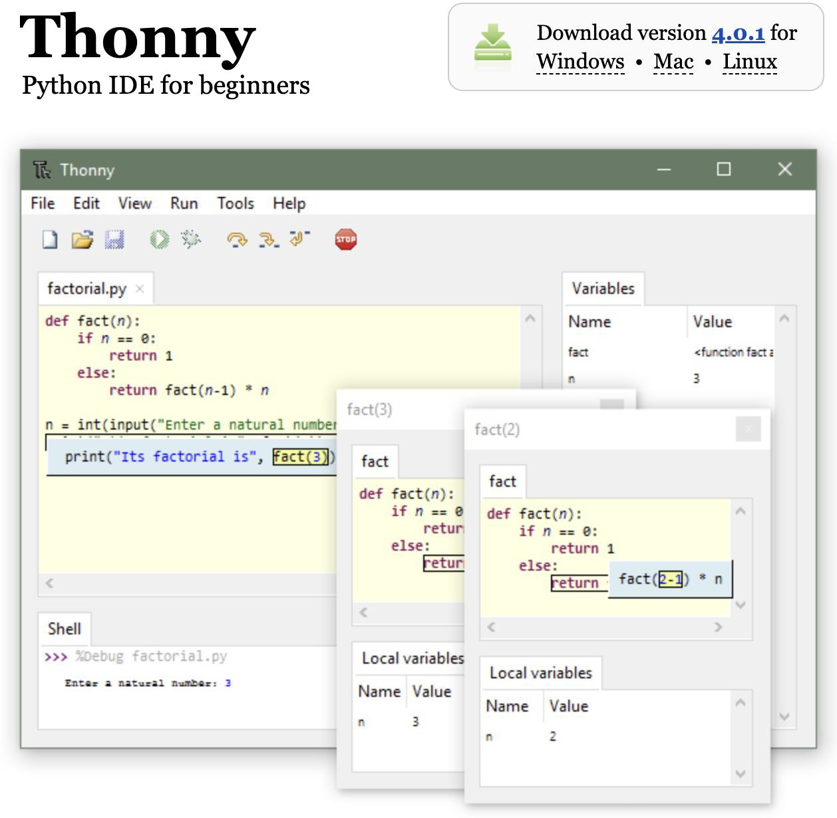
Download Thonny IDE
Thonny IDE was part of the Raspberry Pi Operating System (formerly Raspbian) for ages.
It is a Python IDE that is beginner friendly.
Easy to get started and simple to debug codes.
Download the Thonny IDE from https://thonny.org/

Slide 3
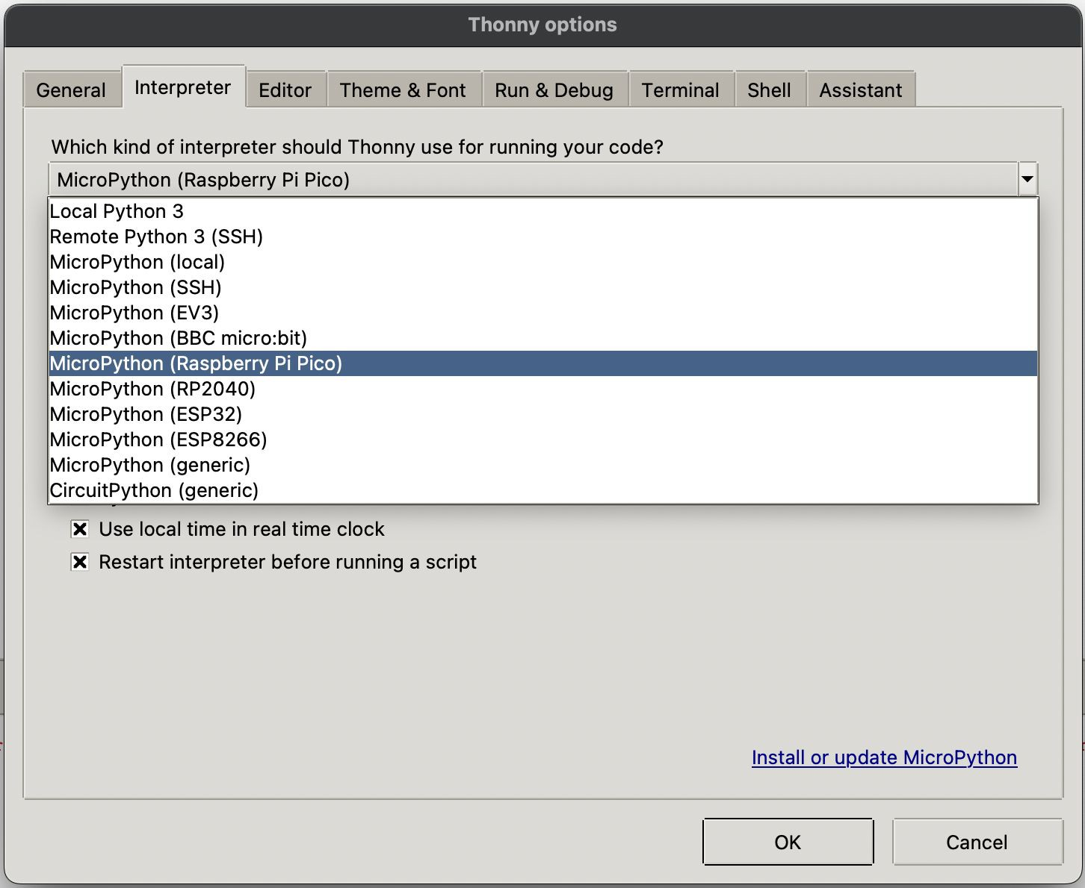
Conﬁgure Thonny IDE
Open up Thonny IDE software.
Go to ‘Tools’ -> ‘Options’, and under ‘Interpreter’ tab, select ‘MicroPython (Raspberry Pi Pico)’.
Click ‘OK’ to close.

Slide 4
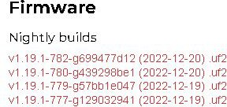
Download MicroPython UF2 ﬁle
MicroPython is a lean and efficient implementation of the Python 3 programming that includes a small subset of the Python standard library.
MicroPython aims to be as compatible with normal Python to allow code transfer from the desktop to a microcontroller with ease.
Go to https://micropython.org/download/rp2-pico-w/
Recommend to download the latest nightly build ﬁrmware.

Slide 5
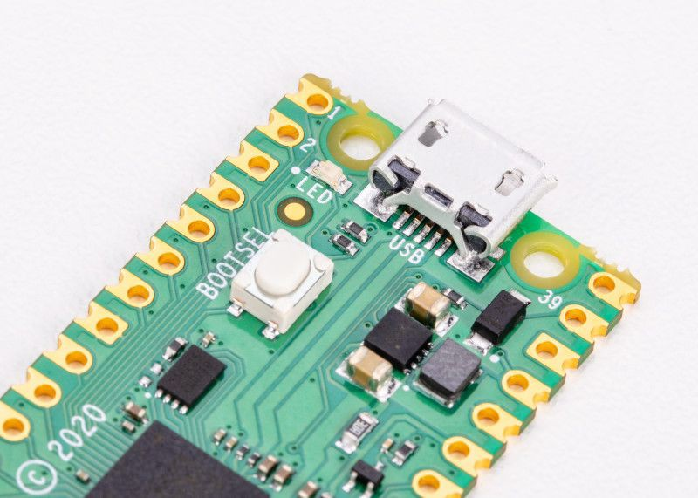
Boot and Install MicroPython
To get started on the Raspberry Pi Pico W, you need to connect a microUSB cable to the Pico W board.
Before you plug the other end into the computer, press and hold the BOOTSEL button.
Continue to hold the button for a few more seconds after connecting to the computer before releasing.
A new drive (RPI-RP2) will appear on your computer.
Drag and drop the UF2 ﬁle onto the RPI-RP2 drive.
The Pico W will auto reboot and run MicroPython.

Slide 6
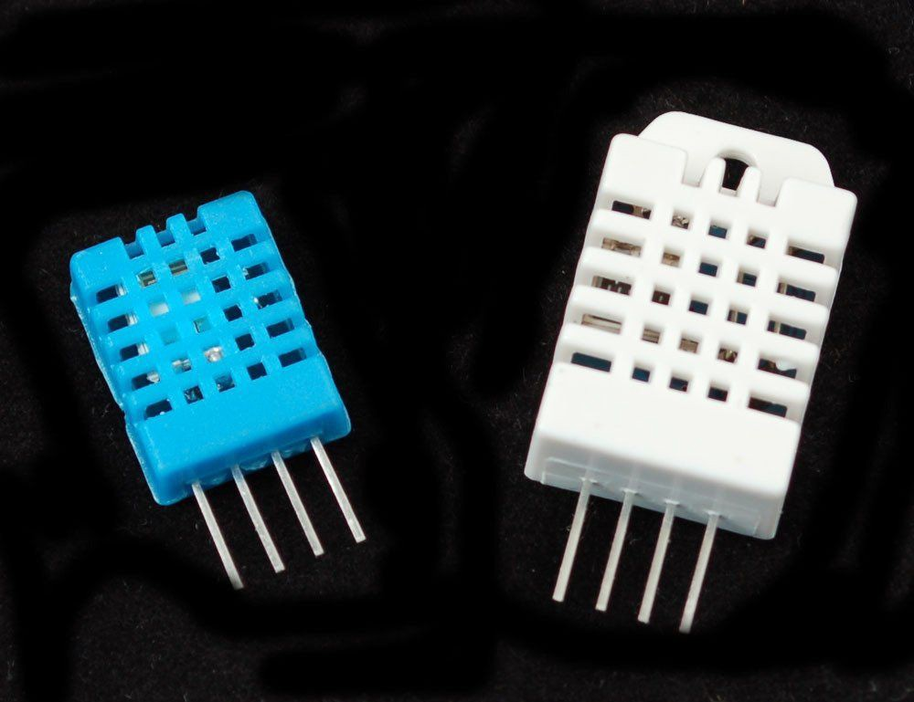
DHT Sensors
The DHT sensors are made of two parts, a capacitive humidity sensor and a thermistor.
There is also a very basic chip inside that does some analog to digital conversion and spits out a digital signal with the temperature and humidity.
The two popular DHT sensors are DHT11 and DHT22.
DHT11
Ultra low cost
3 to 5V power and I/O
2.5mA max current use during conversion (while requesting data)
Good for 20-80% humidity readings with 5% accuracy
Good for 0-50°C temperature readings ±2°C accuracy
No more than 1 Hz sampling rate (once every second)
Body size 15.5mm x 12mm x 5.5mm
4 pins with 0.1" spacing
DHT22
Low cost
3 to 5V power and I/O
2.5mA max current use during conversion (while requesting data)
Good for 0-100% humidity readings with 2-5% accuracy
Good for -40 to 80°C temperature readings ±0.5°C accuracy
No more than 0.5 Hz sampling rate (once every 2 seconds)
Body size 15.1mm x 25mm x 7.7mm
4 pins with 0.1" spacing

Slide 7
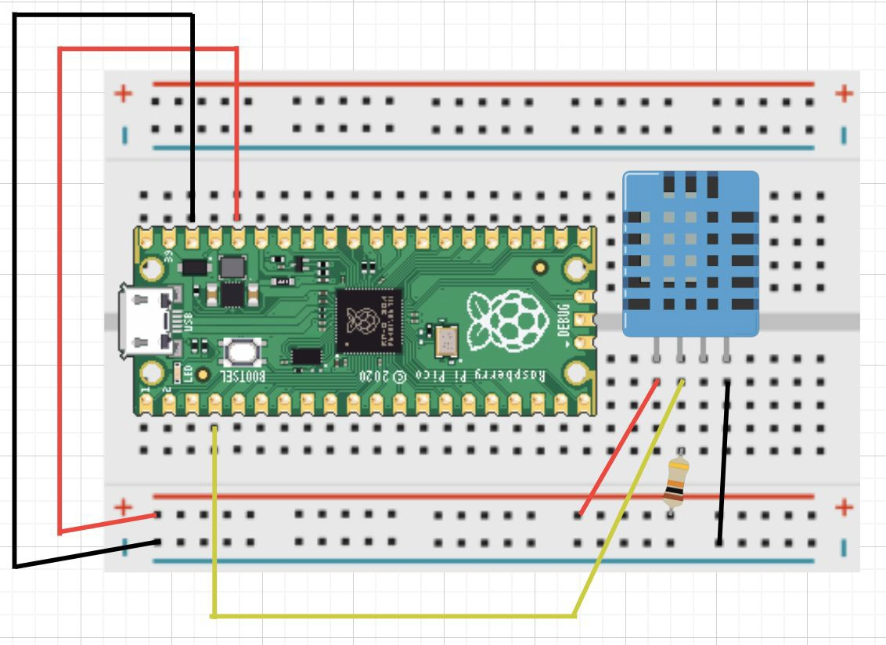
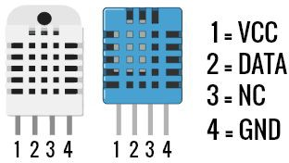
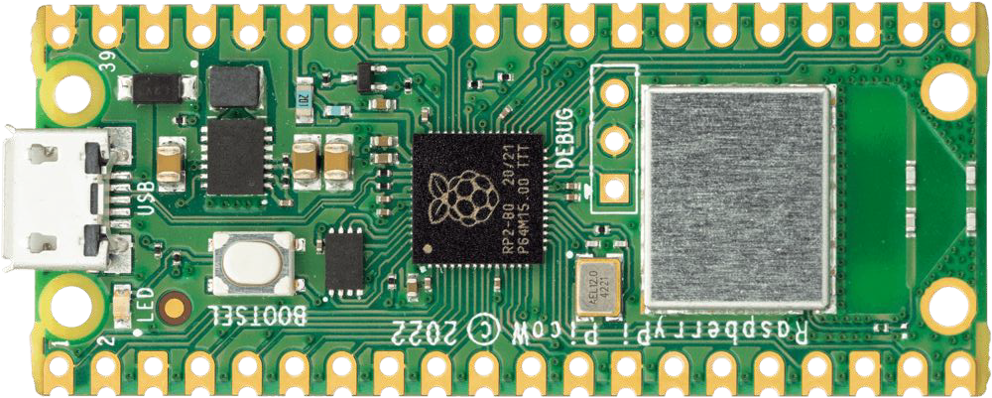
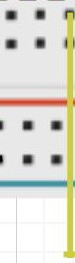
Connect Pi Pico W to DHT Sensor
Connect the DHT11 to Raspberry Pi Pico W as follows:
DHT Pin 1 to 3V3,
DHT Pin 2 to GP4,
DHT Pin 4 to GND.

Slide 8
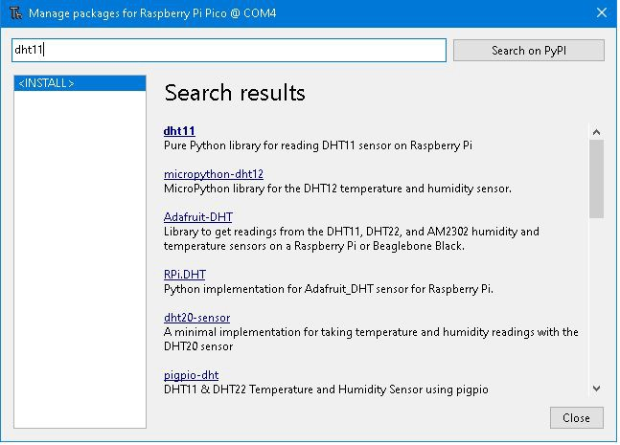
Install DHT11 MicroPython Library
In Thonny, click on ‘Tools’ -> ‘Manage packages…’ and type ‘dht11’.
Select the micropython version and install it.

Slide 9
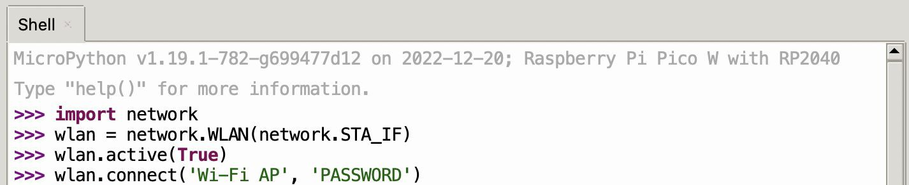
Thonny IDE
Before proceeding, there are a few steps required.
Open Thonny and in the Python shell, write the following lines to connect the Pi Pico W to Wi-Fi:
[Important !!!] Change the “Wi-Fi AP” and “PASSWORD” to match the details of your Wi-Fi Access Point.
Remember to press Enter at the end of each line.
84

Slide 10
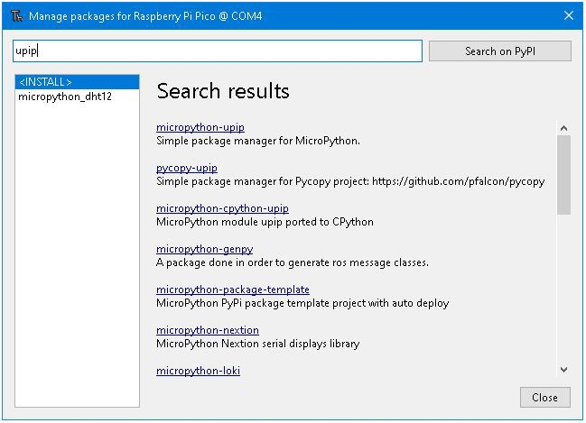
Install upip MicroPython Library
In Thonny, click on ‘Tools’ -> ‘Manage packages…’ and type ‘upip’.
Select the micropython version and install it.
85

Slide 11
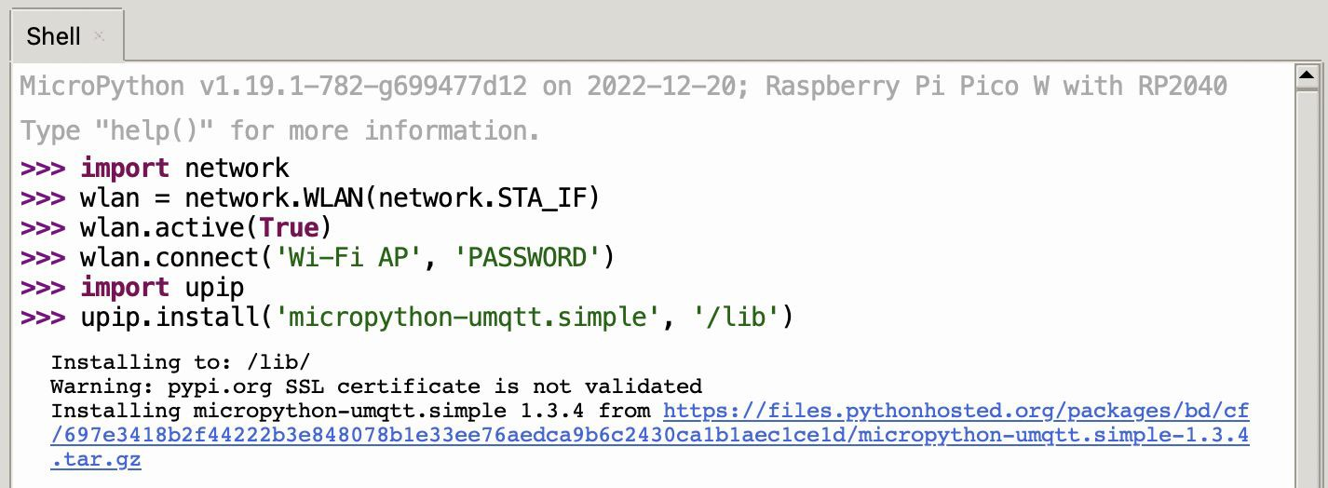
Thonny IDE
Import the upip module. The upip module is a version of the Python package manager, pip, for MicroPython.
Using upip, install ‘micropython-umqtt.simple’ in the ‘/lib’ directory. This module is a simpliﬁed MQTT client for MicroPython.
11

Slide 12
Activity: Setup Raspberry Pi Pico W To Sense Environmental Data
Setup the Raspberry Pi Pico W to gather environmental data using the DHT11 sensor.
12

Slide 13
Sensing Environmental Data
from machine import Pin from time import sleep import dht
sensor = dht.DHT11(Pin(4)) while True:
sensor.measure()
temp = sensor.temperature() hum = sensor.humidity()
print(“Temperature: {}°C Humidity: {}% ”. format(temp, hum)) sleep(2)

Slide 14
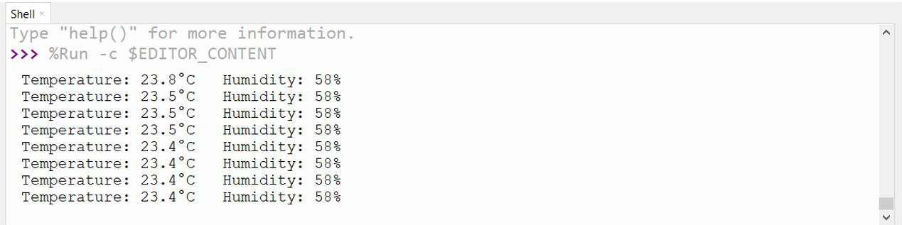
MicroPython DHT11 Pico W Code
The MicroPython script reads temperature and humidity readings from the DHT11 sensor.
These readings will be printed on the MicroPython shell console as seen below.

Slide 15
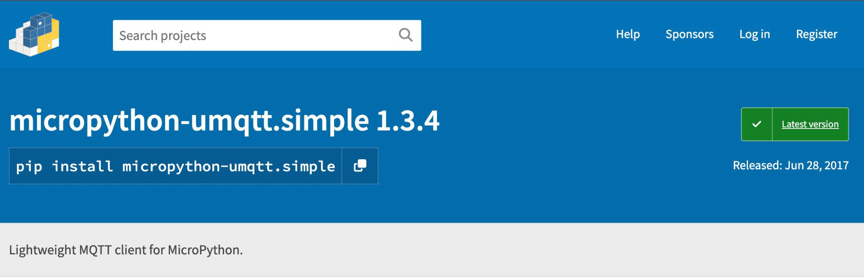
Installing a Python Package
To allow us to communicate between the Raspberry Pi Pico W and the IoT Hub, we’ll be using MQTT.
To enable this, we’re going to download a MicroPython
IDE (“Thonny”), install the latest ﬁrmware and install a micropython module called “umqtt.simple” (https://pypi.org/project/micropython-umqtt.simple/).

Slide 16
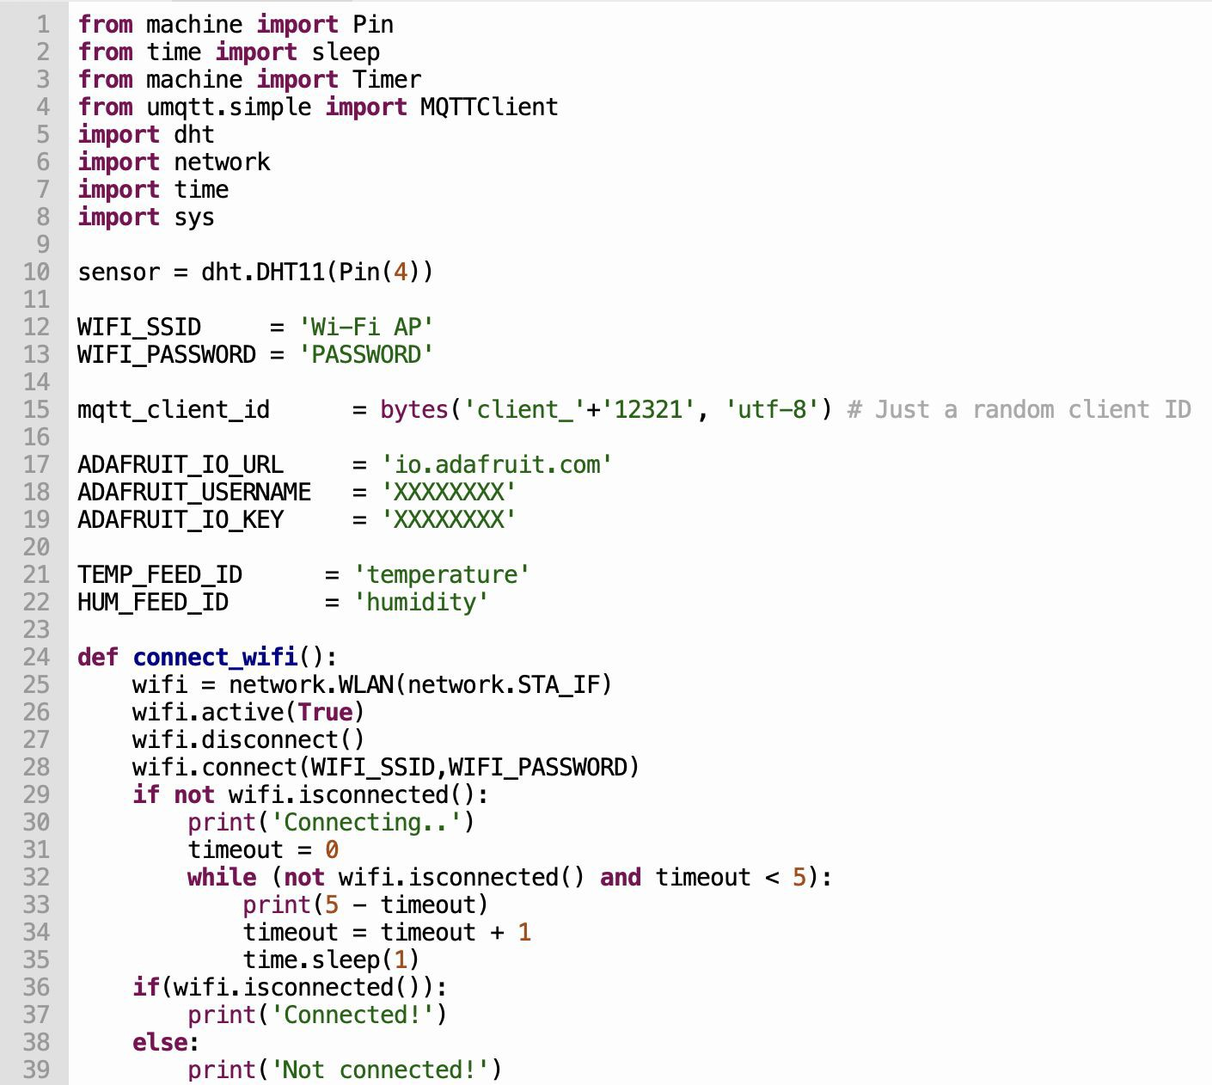
Sending Data To The Cloud

Slide 17
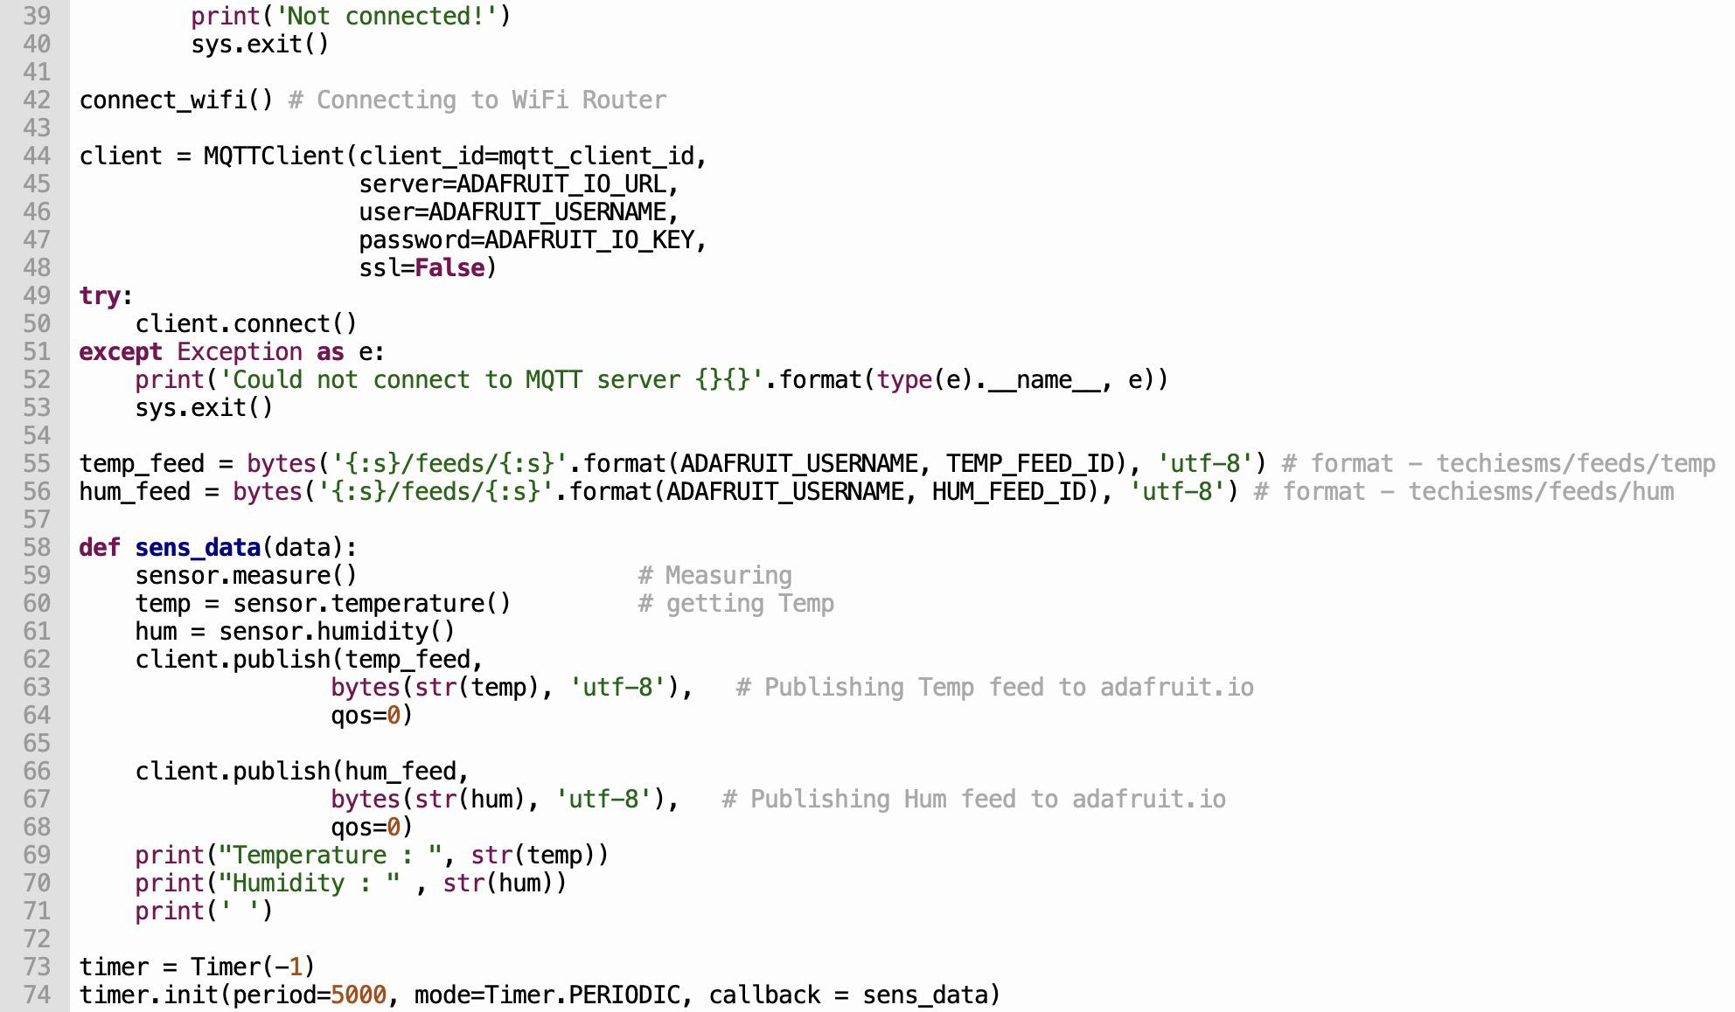
Sending Data To The Cloud

Slide 18
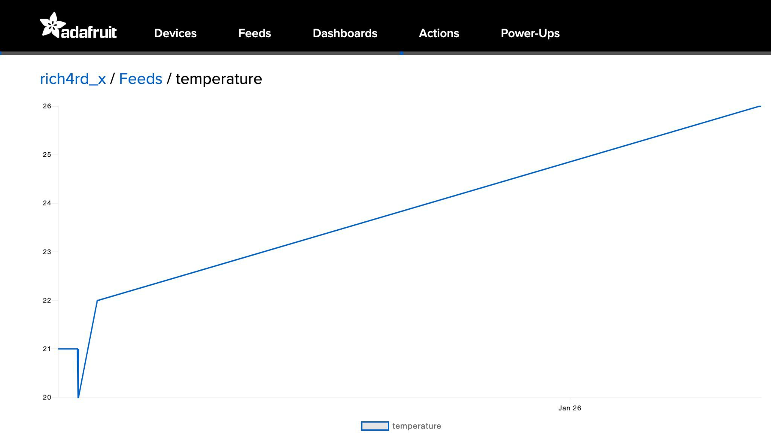

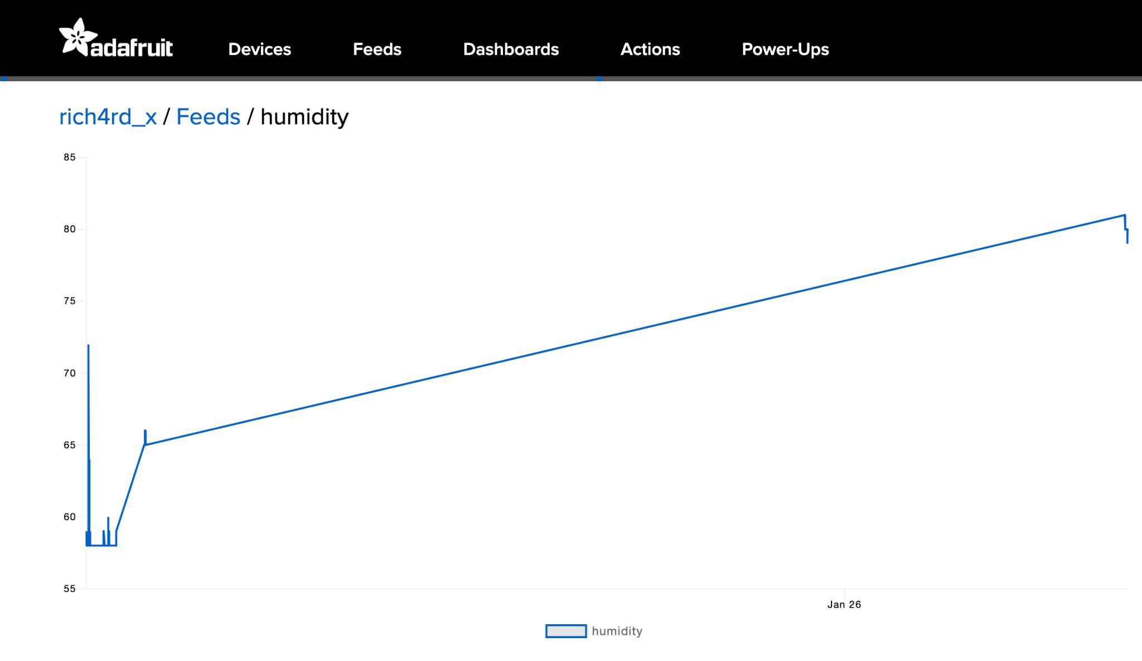
Adafruit.io DHT11 Pico W Code
The MicroPython script reads temperature and humidity readings from the DHT11 sensor.
These readings will be sent to the Adafruit.io individual feeds as seen below.

Slide 19
Topic 2
IoT Data Analytics and Visualization

Slide 20
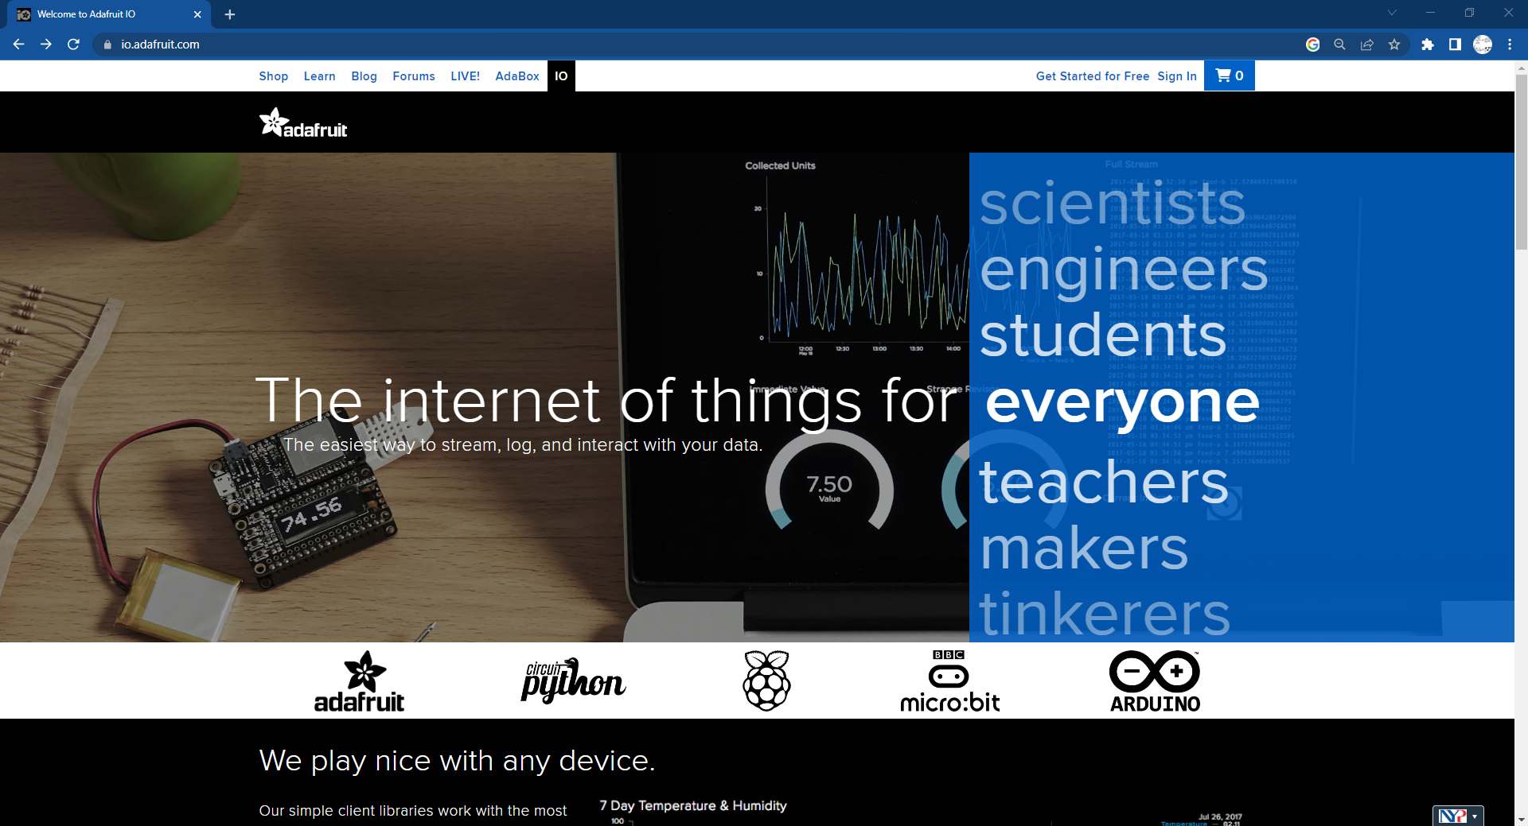


Sign up an Account on Adafruit .io
https://accounts.adafruit.com/users/sign_in
Press HERE

Slide 21
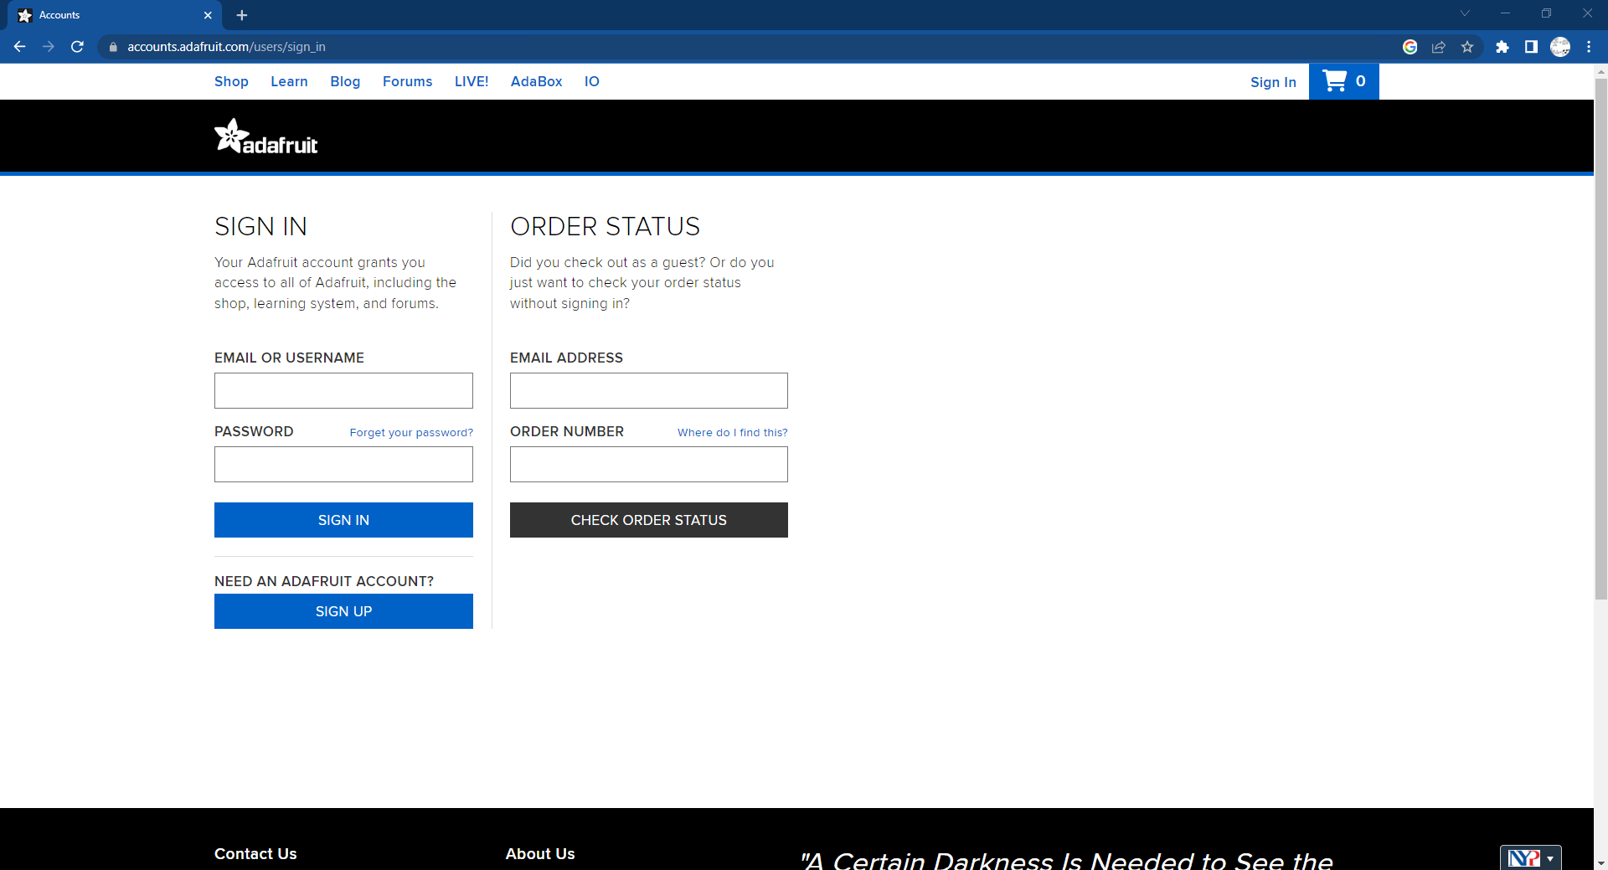

Slide 22
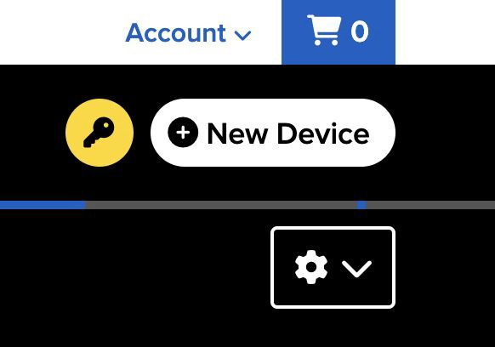
Sending Data To The Cloud
There are a few things to note before you continue to program the Micropython code.
Change the WIFI_SSID & WIFI_PASSWORD in order to connect to the Raspberry Pi Pico W to the network.
You will need your unique Adafruit IO Key, mainly when sending data to the cloud, which can be located as shown below.

Slide 23

Create Adafruit.io Dashboard
We have created two feeds (‘temperature’ & ‘humidity’) that are receiving environmental data.
Under the “IO” header, click “Dashboard” and create a “New Dashboard”.
The dashboard will be used to display the environmental data that are recorded in the feeds.

Slide 24
IoT Data Analytics
We have successfully sent environmental data to the cloud (respective Adafruit.io feeds) that we have created earlier.
Now, we will convert these data and display them into a dashboard to better visualize the environmental data.
In order to do so, we will need to create a Adafruit.io Dashboard ﬁrst.

Slide 25
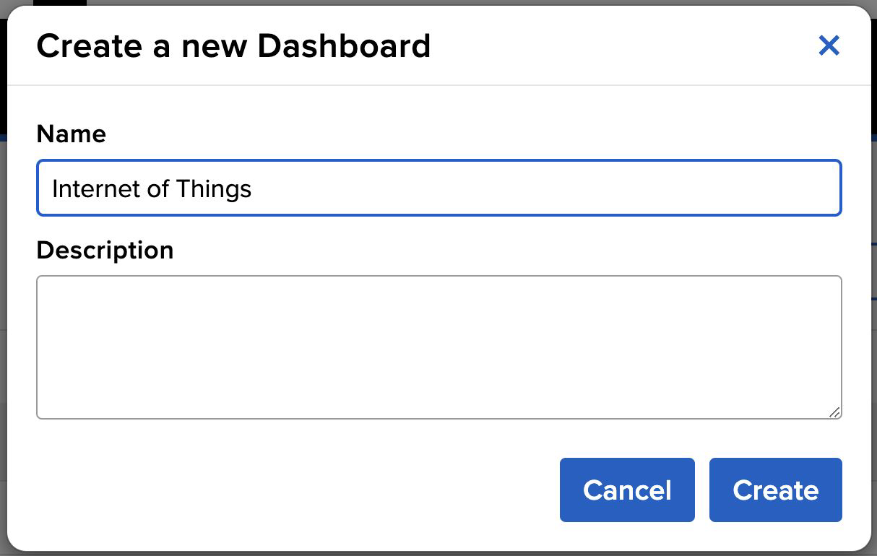
Create Adafruit.io Dashboard
After clicking on “New Dashboard”, you will be prompted to give the dashboard a name and description (optional).
Once done, click the “Create” button.

Slide 26

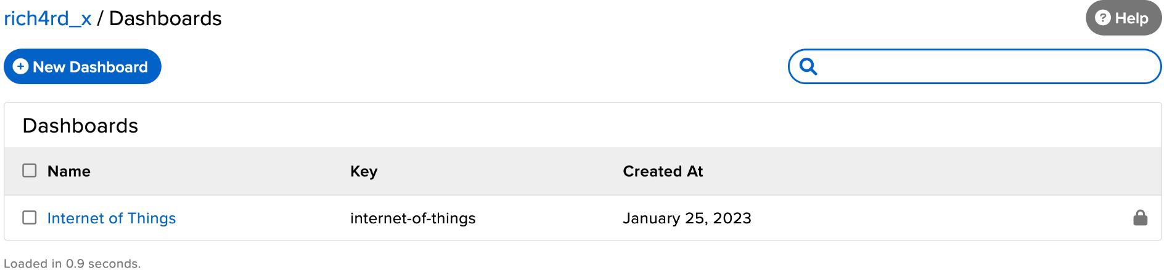
Completed Adafruit.io Dashboard
Once you have created the dashboard, it should look like this.
Click on the newly created dashboard (‘Internet of Things’).

Slide 27
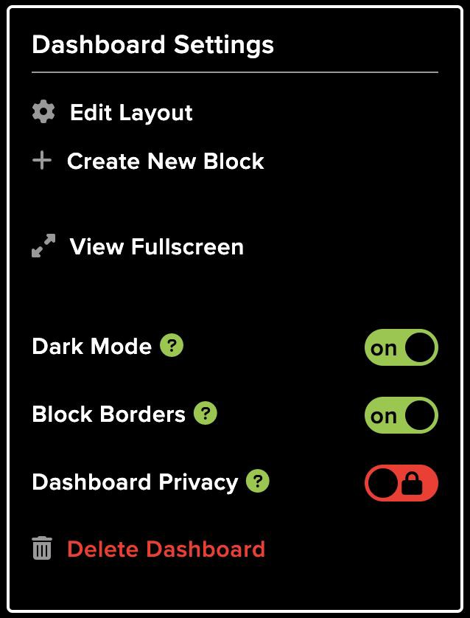
Setup Dashboard Blocks
On the newly created dashboard, you will not see any blocks.
We will create two blocks that will be used to display the environmental data on the dashboard.
Click on the settings dropdown icon and click “Create New Block”.

Slide 28
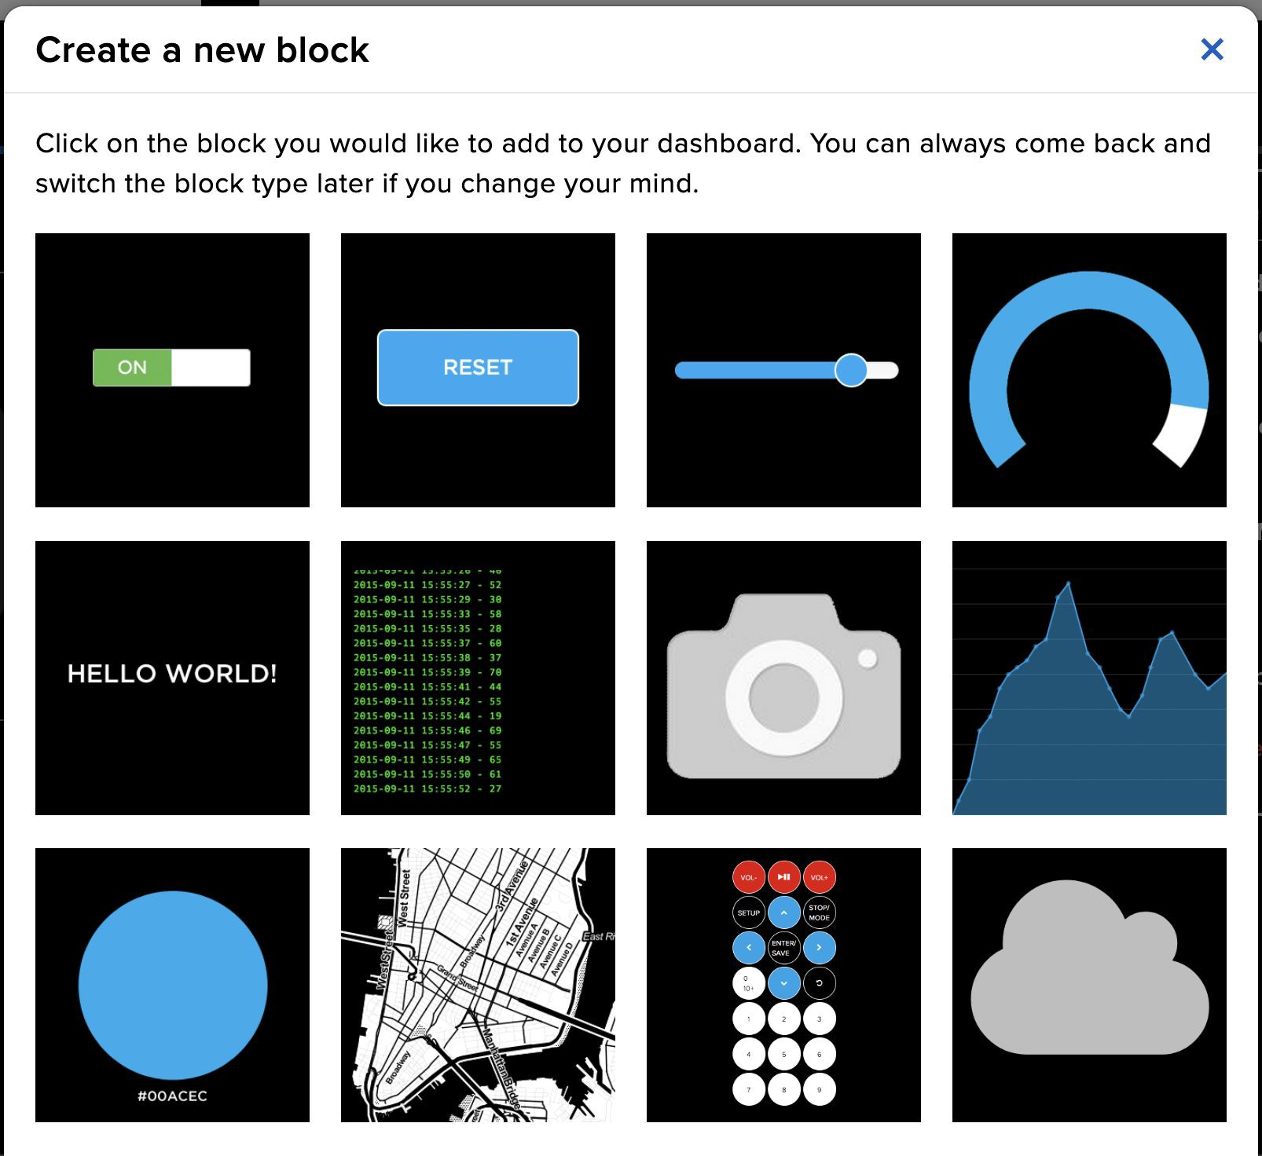
Setup Dashboard Blocks
You will have many options to choose from.
For now, choose the gauge block.
Select the ‘temperature’ feed and click “Next step”.

Slide 29
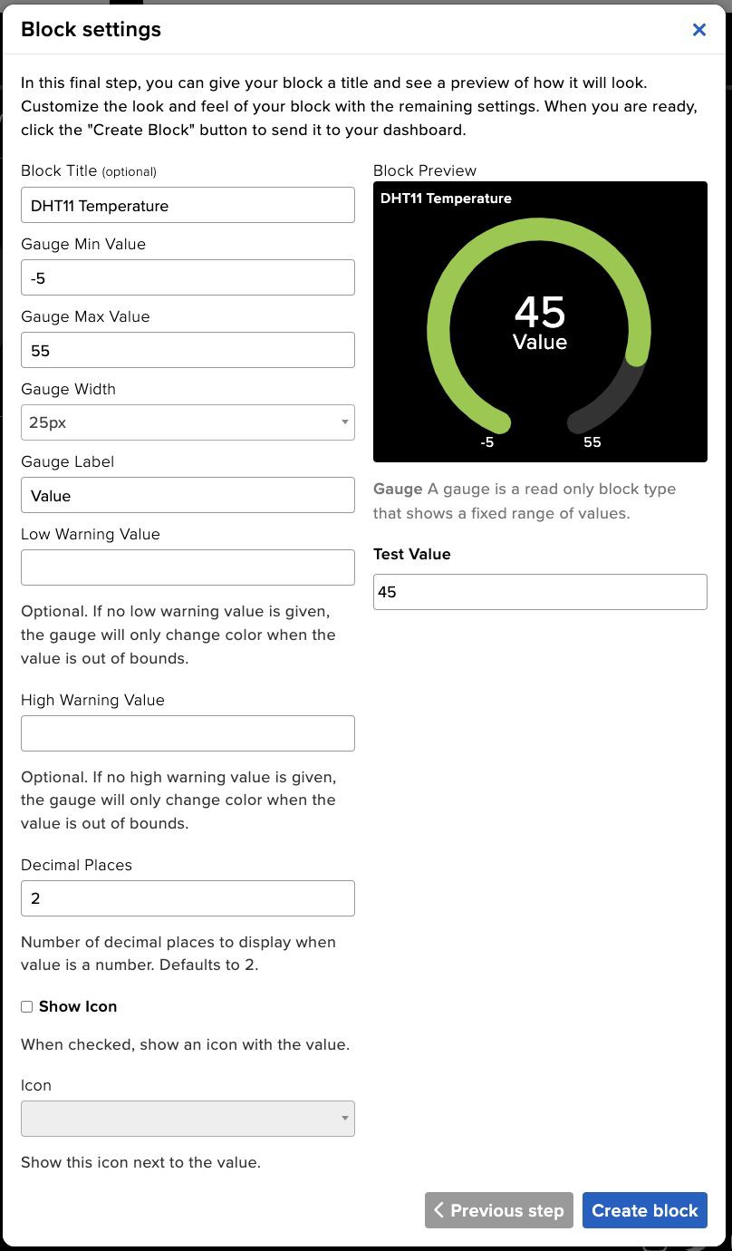
Setup Temperature Block
Under the Block settings, setup the block as shown for the Temperature gauge:
Block Title (optional)
Gauge Min Value
Gauge Max Value
Once done, click “Create Block”.
Repeat the same process for the Humidity gauge.

Slide 30
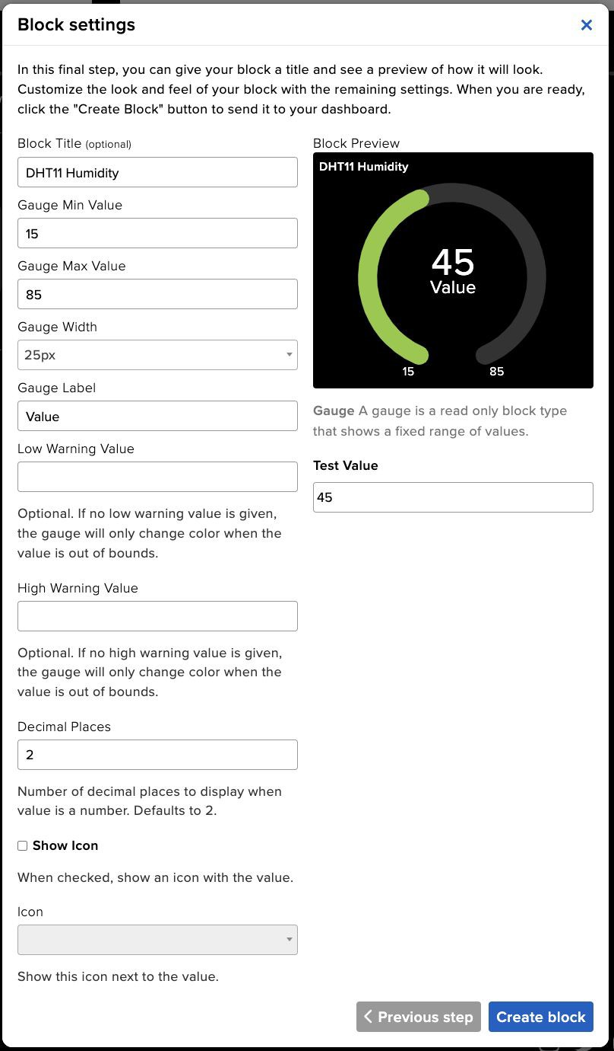
Setup Humidity Block
Under the Block settings, setup the block as shown for the temperature gauge:
Block Title (optional)
Gauge Min Value
Gauge Max Value
Once done, click “Create Block”.

Slide 31
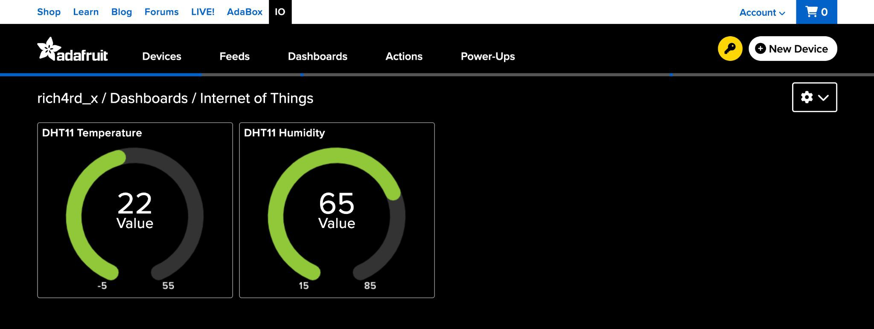
Completed Adafruit.io Blocks
Once you have created the two blocks, it should look something like this.
Your new blocks may not be in the same layout as shown.
However, you can change the layout to whatever that you prefer under the ‘Dashboard Settings’.

Slide 32
Analysing The Dashboard Data
You have written the code to send environmental data to the cloud successfully.
Now, the environmental data can be visualized on the dashboard easily.
Going further, you may thinker with the Adafruit.io Dashboard settings for each gauge to set Low and High warning values.

